Slide 1
Employee Data Analysis using Excel
STUDENT NAME: Bhuvanashree.T
REGISTER NO : 312211707
DEPARTMENT : B.com (General)
COLLEGE :Thiruthangal Nadar College

Slide 2
Project title
Employee Performance Analysis Using Excel

Slide 3
Agenda
Problem Statement
Project Overview
End Users
Our Solution and Proposition
Dataset Description
Modellling Approach
Results and Discussion
Conclusion

Slide 4
Problem statement
Employee attrition, or turnover, is a critical challenge for organization as it can lead to increased costs, decreased productivity, and loss of valuable talent. Despite various efforts to improve employee retention, the company has been experiencing a steady increases inattrition rates over the past few years. This trend raises concerns about the underlying factors contributing to employee departures.

Slide 5
Project overview
Objective
The objective of this project is to understand the underlying factors contribution to employee attrition within the organization and to develop predictive models that can help identify employees who are at risk of leaving.
Scope
1. Data collection
2. Exploratory Data Analysis(EDA)
3. Model Development
4. Key Findings and Insights
5. Recommendations
6.Implementation and Monitoring

Slide 6
Who are the end users?
Human Resources(HR)
Senior Leadership and Executives
Line Managers and Team Leaders

Slide 7
Our solution and proposition
Solution
Our employment attrition analysis provides a comprehensive ,data-driven approach to understanding and mitigating employee turnover within an organization. The solution involves collecting and analyzing historical employuee data to attrition and developing predictive models that can forecast which employees are at risk of leaving.
Key components of our solution include:
1.Data Integration and Analysis
2.Predictive Modeling
3.Actionable Insights
4.Customized Retention Strategies

Slide 8
Dataset description
The dataset for employement attrition analysis typically consists of various featrures (or columns) that capture both demographic and emploment-related information about employees. Below is a description of the key components of the dataset.
1.Demographic Information
2.Employement Information
3.Compensation and Benefits
4.Performance and Engagement

Slide 9
Modelling approach
Data filtering
Purpose: To sort and refine the data to focus on specific criteria, such as department, data range, or individual employee perfoemance.
Implementation: Excel's filtering feature will be applied to datasets, allowing users to easily narrow down the data to view only the relevant information.
Pivot Tales
Purpose: To summarize and analyze large datasets by grouping and aggregating data based on different performanve metrics.
Implementation: Pivot tables will be used to dynamicallly calculate and display key performance indicators (KPIs) such as average task complention time,total hours worked, or percentage of targets met.

Slide 10
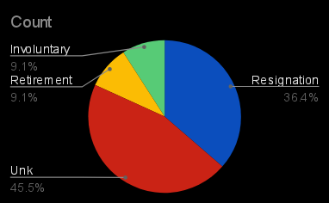
Results: pie chart

Slide 11
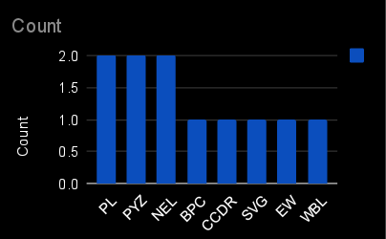
Bar diagram

Slide 12
Discussion
Interpretation of Results
Practical implications
Limitations of the Study
Future Directions

Slide 13
Conclusion
The employment attrition analysis provided valuable insights into the factors driving employee turnover within the organization. By leveraging predictive analytics and data-driven strategies, the organization can now take targeted actions to improve employee retention, reduce turnover, and enhance overall organizational performance. The results and insights from this analysis will serve as a foundation for ongoing HR strategy development and workforce planning initiatives.

